Slide 1
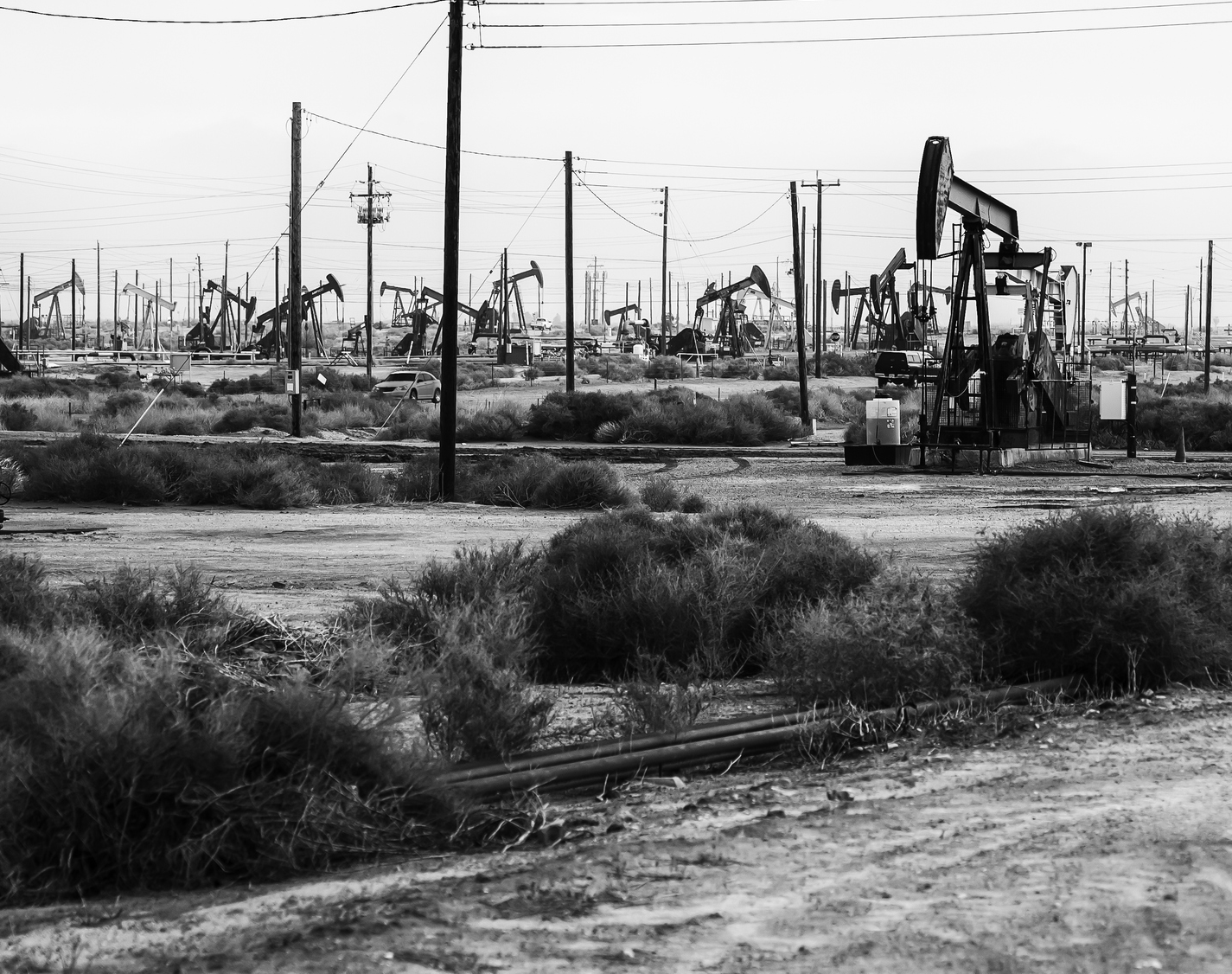
Interaction Between Emerging Climate Disclosure Regulation and the Paris Agreement:
A Test for the Operationalization of Sustainable Development in Law
Presentation for the Conference:
Sustainable Development as a Fundamental Pillar of Economic Governance and Public Affairs
Ravenna, 9-10 November 2023
By Charles Codère
Postdoctoral researcher
NEME Chair – Laval University, Quebec, Canada

Slide 2
Structure of the presentation
Law, economics, and the environment: Lawrence Lessig’s new Chicago school applied to the climate
The current framework for GHG reporting
    GHG reporting under the Paris Agreement
    Domestic reporting frameworks: insights from Canada and the United States
The emerging climate disclosure standards
    Overview of current initiatives
    Some remaining questions
©Charles Codère

Slide 3
Law, economics and the environment
3 core concepts:
Individuals, companies and States as economically rational actors
Sustainable development as an « environmentally efficient » equilibrium to be reached
Climate change as a common good
- « Tragedy of the commons » (Hardin)
- Need for regulatory intervention
©Charles Codère

Slide 4
Lessig’s New Chicago School: from cyberspace to planetary boundaries
Based on « old»/traditional law and economics, but more nuanced: four main normative forces that influence actors
Architecture: planetary boundaries as norms that must be taken into account
Key lesson from Lessig: understanding a resource is a key precondition to its effective regulation
  Example of international law for the protection of the ozone Layer
Source: Lessig (1998)
©Charles Codère

Slide 5

The Current UNFCCC GHG Reporting Framework
Regulation, from general to specific:
  From overall goal (UNFCCC) to quantified target (Paris)
  From GHG mitigation targets for some States (Kyoto), to all States (Paris)
…but States Parties are still far from aligning national emissions with the Paris Agreement’s 1.5°C/2°C target
Reporting under UNFCCC rules: IPCC guidelines
  Sectoral approximations
  Designed to be feasibly implementable by all States Parties
  Tradeoff: lower precision
©Charles Codère

Slide 6
Domestic Reporting Frameworks: the Case of Canada and the US
Criteria | Canadian GHGRP | United States GHGRP
Annual emissions threshold for inclusion | 10,000 metric tons CO₂e/y | 25,000 metric tons CO₂e/y
Emissions scopes covered | Scope 1 | Scope 1 for all Scope 3 for suppliers
Sector-specific norms not covered by other program | Base-metal production Iron and steel production Ethanol production | Production of 7 types of chemicals
Percentage of national emissions covered | 43% | 85-90%
©Charles Codère

Slide 7
The Emerging Carbon Disclosure Standards
Criteria | UK | EU | US SEC | US California | ISSB
Threshold for inclusion | Quoted companies « Large » companies Certain public entities Energy threshold of 40MWh/y | Most companies listed on EU markets « Large » EU non-listed companies « Large foreign companies with significant EU activity » | Companies publicly traded on US markets | Business entities with a total annual revenue of more than 1 billion USD and « [doing] business in California » | Publicly traded companies
Emissions scopes covered | Scopes 1-2 | Scopes 1-2-3 | Scopes 1-2-(3?) | Scopes 1-2-3 | Scopes 1-2-3
Enforcement | Fines for non-compliance, amount unclear | To be determined by Member States | ? | Administrative fines of up to 500,000$ | To be determined by States
Timeline for implementation | In force since 2019 | In force since 2023 Implementation from 2024 to 2028 | Adoption planned for 2024 Implementation from 2026 | In force since 2023 Implementation in 2026-2027 | Effective since 2023 Must be integrated into domestic law
More comprehensive than the preexisting frameworks, but…
©Charles Codère

Slide 8
Where do we go from here?
Some remaining questions:
From fragmentation to coordination?
  Mixed signals
What about enforcement?
  Key to avoid « Dieselgate 2 »
Integration with Paris Agreement norms and mechanisms?
  Global Platform for Climate Action (GCAP)…improved transparency?
  Global Stocktake…measurement of « participation of non-Party stakeholders »?
©Charles Codère

Slide 9

Grazie!

